Slide 1
SMART VIRTUAL LABS
Guided by : Dr. Jyoti Pareek
Presented by : Rinkesh Patel 18
Anand Solanki 25

Slide 2
Objective
In classroom based learning a teacher can observe the ability of a student like whether a student is fast learner or slow learner, based on that a teacher can recommend different type of learning methods or can choose alternate teaching methods.
In E-learning systems like “Virtual Labs”, students learn their subjects. On such portals to provide such recommendation, we need to observe the type of student.
By observing the ability of student, we can provide personalized learning methods.

Slide 3
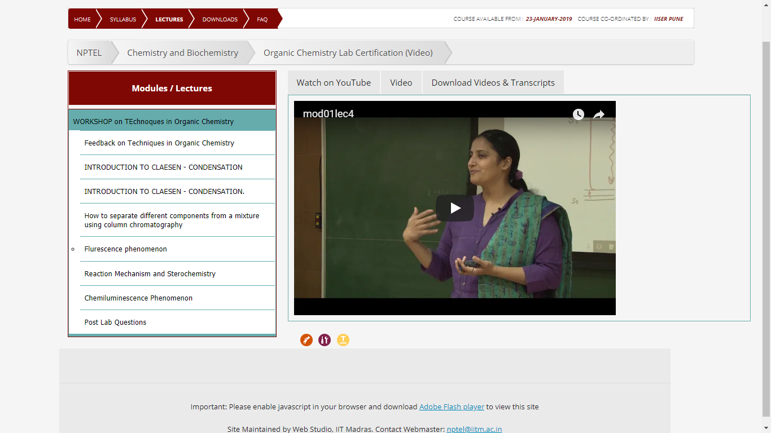

Slide 4
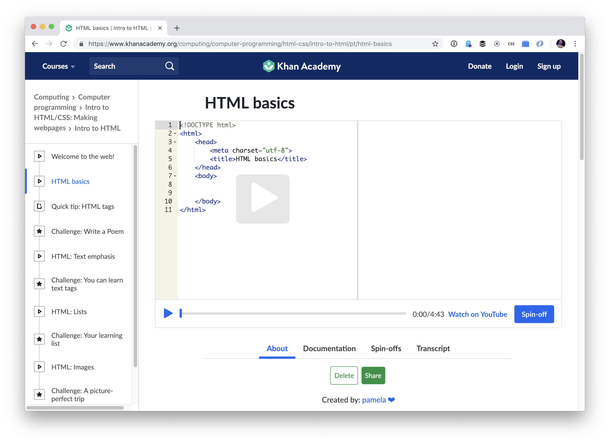

Slide 5
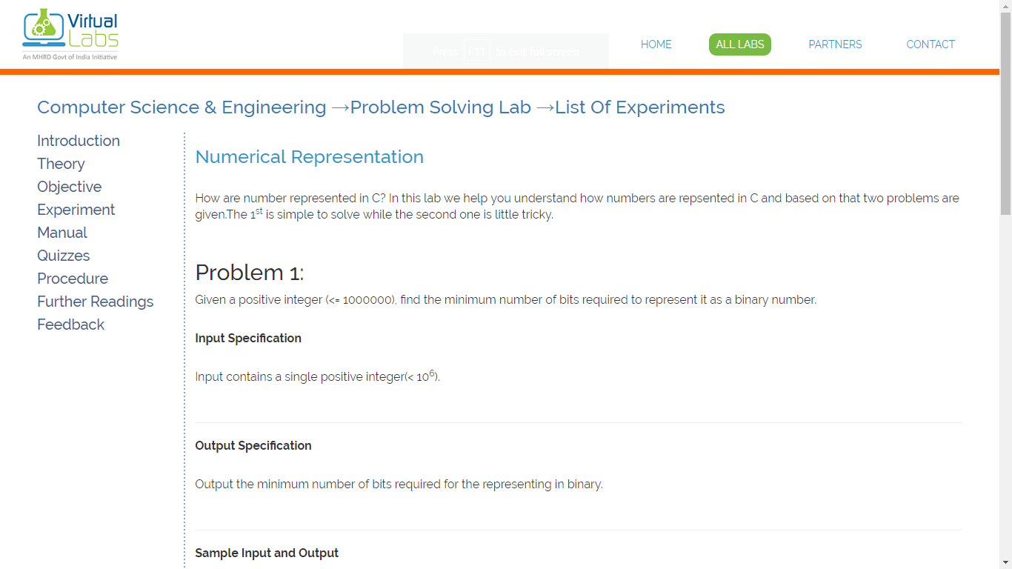

Slide 6
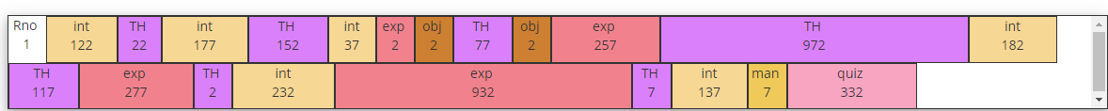
Solution
In order to observe students ability, we need to capture user footprints on E-learning platform, like in which sequence of pages user traverse on platform, how much time he/she spent on each page.

Slide 7
A
By matching this sequence to predefined sequences of different type of students, we can classify the current student like fast learner or slow learner.
To define such sequences we are using Hidden Markov Model.

Slide 8
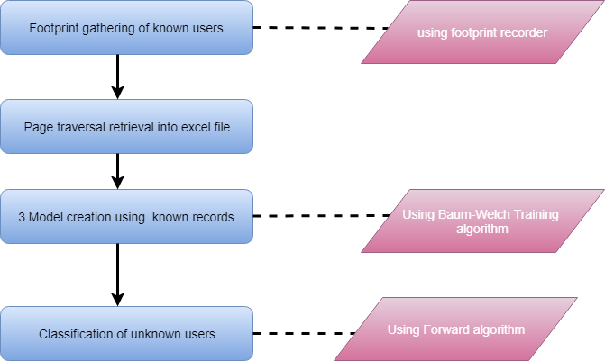
System Flow

Slide 9
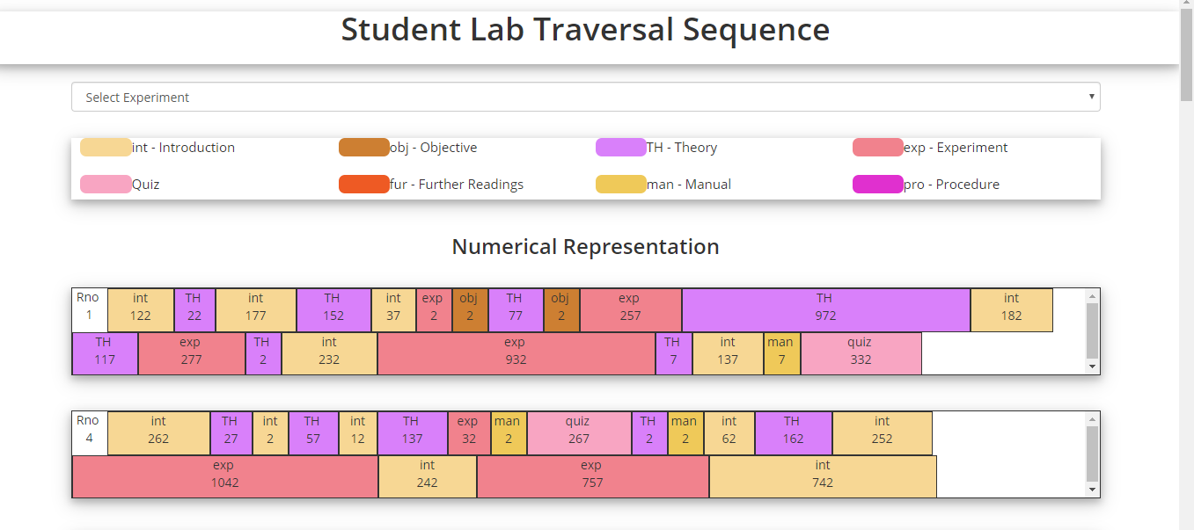
Footprint Gathering

Slide 10
Footprint gathering
In order to record student lab traversal sequences, we have used “Virtual LAB” portal.
To record genuine data patterns we have conducted experiments in department labs, where we asked students of MCA-2 to use the “Virtual LAB” to learn some topics.

Slide 11
Challenges
No historical data.
No access to live portals codebase.
Dynamic portal implementation with PHP and MySQL.
“Virtual LAB” is free to use without LOGIN authentication.
Heartbeat system to record user session.
11

Slide 12
Implementation
Tools:
PHP
MySQL
JavaScript
As student logs into the portal and uses the virtual LAB’s experiments, system records the footprints in the form of page traversal sequence and time spent on each page.
12
12

Slide 13
TblPageUseLog
 | Name | Type | Description
 | LogId (P. K. ) | Int(5) | Auto increment Unique record identifier
 | Username | Varchar2(50) | Name of user
 | UserIP | Varchar2(50) | IP address of the machine
 | LabName | Varchar2(50) | Lab name
 | ExpName | Varchar2(50) | Experiment name
 | PageName | Varchar2(50) | Page name
 | TimeSpent | Varchar2(8) | Time spent in seconds

Slide 14
TblUsers
 | Name | Type | Description
 | UserID | Int(5) | Auto increment Unique record identifier
 | Username | Varchar2(50) | Username of user
 | Password | Varchar2(20) | Password of user
 | Name | Varchar2(100) | Name of user

Slide 15
TblQuizRecords
 | Name | Type | Description
 | ID | Int(5) | Auto increment Unique record identifier
 | Username | Varchar2(50) | Username of user
 | LabName | Varchar2(50) | Name of lab
 | ExpName | Varchar2(50) | Name of experiment
 | Score | Int(3) | Quiz score of user
15

Slide 16
Recorded Sequences

Slide 17
Student Classification

Slide 18
Hidden Markov Model
The Hidden Markov Model (HMM) is a variant of a finite state machine having
a set of hidden states,
a set of observations,
initial state probabilities,
transition probabilities,
emission probabilities.
Hidden markov models are extended version of markov models with addition of hidden states.

Slide 19
Markov Model Model
Markov Chain Property:
probability of each new state depends only on what was the previous state.
Transition probabilities: P(‘Cold’|‘Dizzy’)=0.4, P(‘Normal|‘Dizzy’)=0.3, P(‘Dizzy’|‘Dizzy’)=0.3.
0.3
0.3
0.4
0.2
0.3
0.4
Dizzy
Cold
Normal
0.5
0.4
0.2

Slide 20
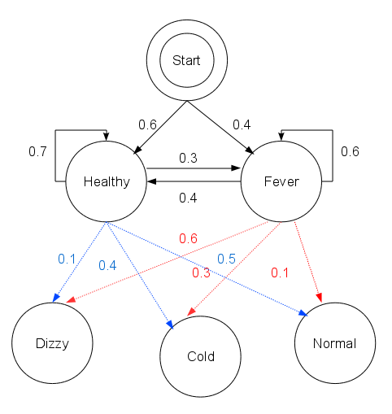
Hidden markov model
In addition to markov models, Hidden markov models have hidden states as well as observations.

Slide 21
Set of States:
Set of Observation:
matrix of transition probabilities:
A=(a_{ij}), a_{ij}= P(s_{i} | s_{j}) ,
matrix of observation probabilities:
B=(b_{i} (v_{m} )), b_{i}(v_{m} ) = P(v_{m} | s_{i}).
a vector of initial probabilities
π=(π_{i}), π_{i} = P(s_{i}) .
Hidden Markov Model is represented by
M=(A, B, π).

Slide 22
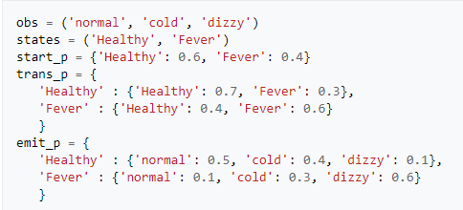
(Cont.)

Slide 23
Observations (Visible states)
Set of Observation:
In example Normal, Cold and Dizzy are the observations or we can say visible states.
In our case observations are Excellent performer, Good performer, Below average performer.

Slide 24
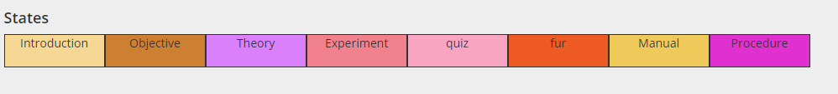
Hidden States
Set of States:
These are the hidden states which can affect the visible states(observations).
Healthy and Fever are the hidden states.

Slide 25
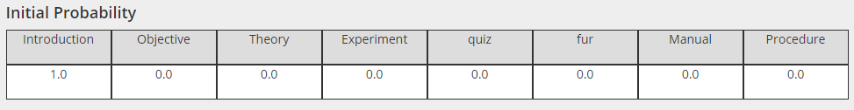
Initial probability
A vector of initial probabilities
π=(π_{i}), π_{i} = P(s_{i}) .
Initial probabilities represents which state the HMM is in when user first open particular lab on platform.

Slide 26
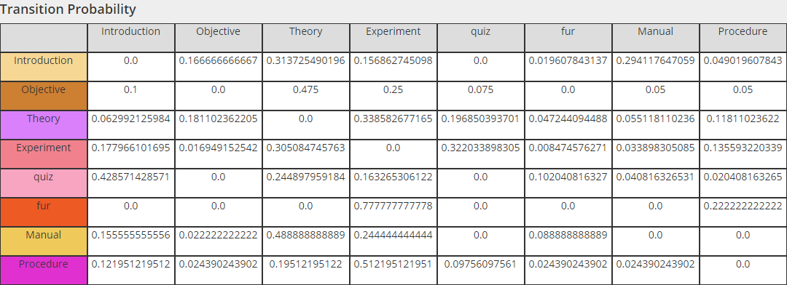
Transition probability
matrix of transition probabilities:
A = (a_{ij}), a_{ij} = P(s_{i} | s_{j}) ,
It is the probability of transitioning from one state to another in a single step.

Slide 27
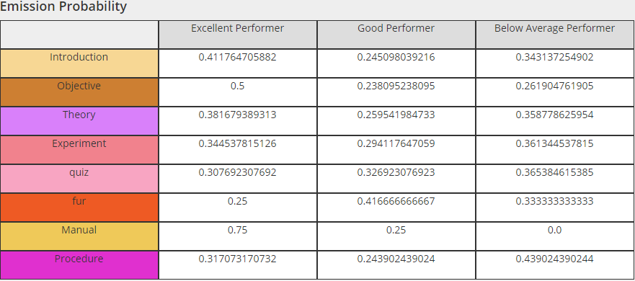
Emission probability
matrix of observation probabilities:
B = (b_{i} (v_{m} )), b_{i}(v_{m} ) = P(v_{m} | s_{i}).
It is the probability of getting an observation based on a particular hidden state.

Slide 28
HMM applications
Speech recognition, including Siri
Part-of-speech tagging
Handwriting recognition
Alignment of bio-sequences
Time series analysis
Activity recognition
DNA motif discovery

Slide 29
3 problems and their solution in HMM
Evaluation Problem:
Given the HMM M=(A, B, π) and the state sequence S=s1, s2 ... sK , calculate the probability that model M has generated sequence s .
Forward algorithm
Backward algorithm.

Slide 30
Decoding Problem:
Given the HMM M=(A, B, π) and the observation sequence O=o1,o2 ..., oK , calculate the most likely sequence of hidden states si that produced this observation sequence.
Viterbi algorithm.

Slide 31
Training Problem:
Given some training sequences O=o1,o2,...,oK and general structure of HMM (numbers of hidden and visible states), determine HMM parameters M=(A, B, π) that best fit training data, that maximizes P(O | M) .
Baum Welch algorithm

Slide 32
Hidden Markov Classifier
Generate multiple models for each type of sequence using Baum-Welch training.
In our case 3 models, Excellent, Good and Below Average Performer.
Finally the classifier attempts to select the class with maximum probability given the sequence.

Slide 33
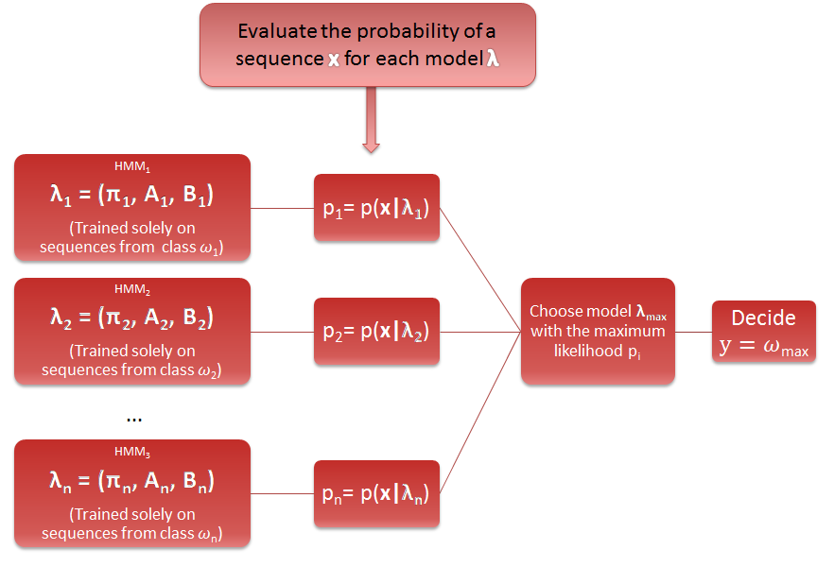
A = transition matrix
B = Emission matrix
= Initial matrix
y = class of input seq.

Slide 34
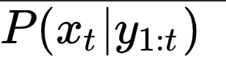
Forward Algorithm
To calculate forward probabilities.
Forward probabilities are written as,
The forward probability for i at time t, ɑ_{t}(i), is the probability that an HMM will output a sequence O₁:t and end in state s_{i}.
34

Slide 35
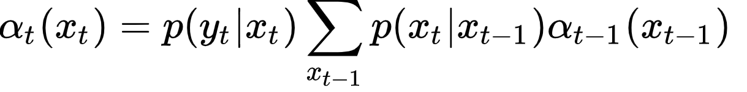


Recursive Formula for forward probabilities
Here,
is the emission probability.
is the transition probability.
is the recursive call to the function.

Slide 36
For example:
Yt : Good Performer
Xt: Introduction

Slide 37
For example:
Xt : Theory
Xt-1: Introduction

Slide 38
Recursive call till t becomes 1.
T=1 are the initial probabilities.

Slide 39
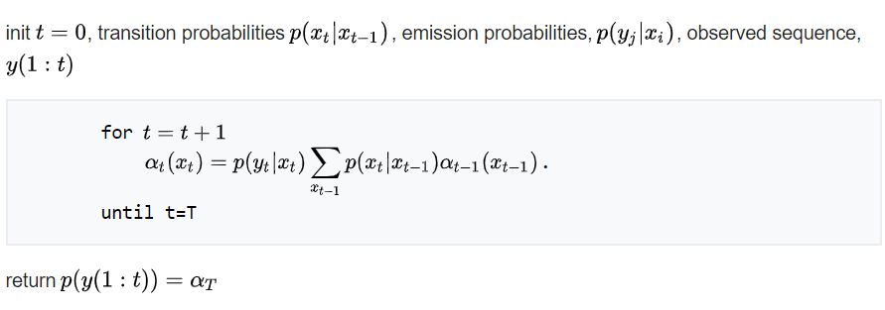
Pseudocode

Slide 40
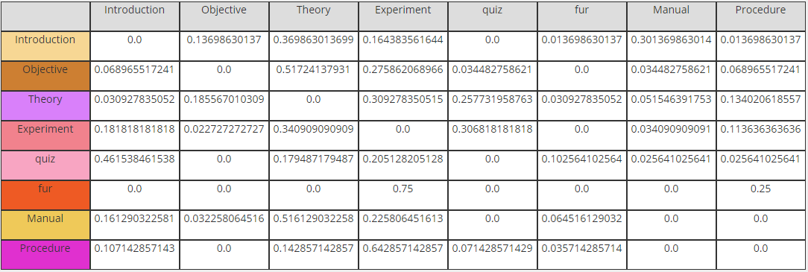
Excellent Performer Forward Probabilities
Time | 1 | 2 | 3 | 4 | 5
input | int | TH | Obj | TH | exp
Prob. | 1.0 | 0.369 | 0.369*0.185= 0.068 | 0.068*0.517=0.0352 | 0.0352*0.309=0.0109
40

Slide 41
Good Performer Forward Probabilities
Time | 1 | 2 | 3 | 4 | 5
input | int | TH | Obj | TH | exp
Prob. | 1.0 | 0.313 | 0.313*0.181= 0.056 | 0.056*0.475=0.0269 | 0.0269*0.339=0.0091

Slide 42
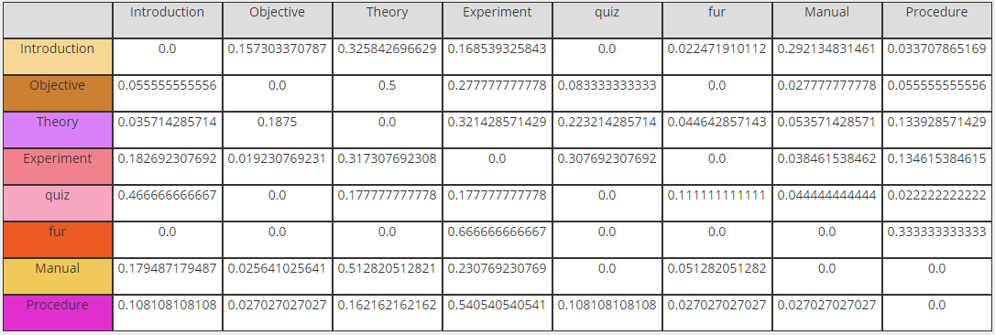
Below average Performer Forward Probabilities
Time | 1 | 2 | 3 | 4 | 5
input | int | TH | Obj | TH | exp
Prob. | 1.0 | 0.325 | 0.325*0.187= 0.0607 | 0.0607*0.5=0.0303 | 0.0303*0.321=0.0097
42

Slide 43
Input sequence to classify
int TH obj TH exp
Probability :
Excellent performer HMM = 0.0109
Good performer HMM = 0.0091
Below average performer = 0.0097
Wmax = 0.0109 (Excellent Performer)

Slide 44
A = transition matrix
B = Emission matrix
= Initial matrix
y = class of input seq.

Slide 45
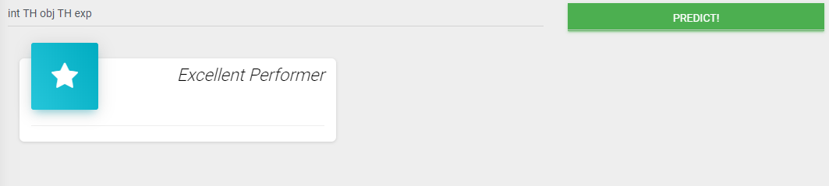
Screenshot

Slide 46
Analysis
Category based performance analysis
Time based analysis
Sequence analysis
Student classification

Slide 47
Category based performance
Total number of Students.
Total of Excellent performer, Good performer and Below average performer.
bar chart represents the average ratio of 3 types of students.

Slide 48
Time based analysis
Time spent by each category of student on different pages of “Virtual LAB” in percentage.
Pie chart represent the average time spent by each category of student on different pages.

Slide 49
Sequence analysis
Graphical representation of:
Sequence followed by Excellent performer.
Sequence followed by Good performer.
Sequence followed by Below average performer.

Slide 50
Student classification
Based on given new sequence classification of student.
Categories:
Excellent performer
Good performer
Below average performer

Slide 51
THANK YOU!

